Slide 1
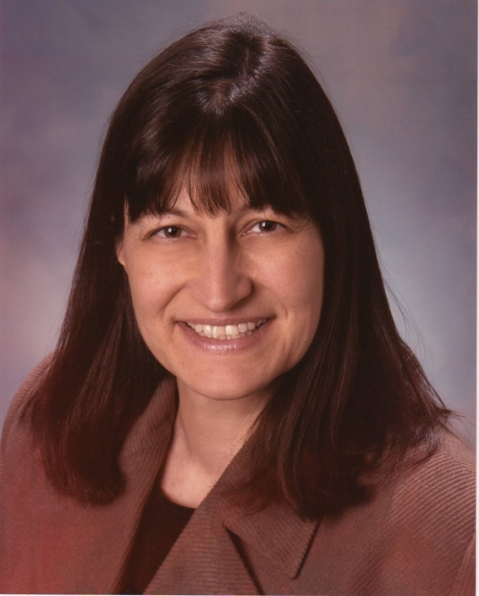
Ohio’s State System of Support (SSoS)
            Pamela VanHorn
            Center for School Improvement Director, State System of Support
            Pamela.Vanhorn@ode.state.oh.us
                June 27, 2011

Slide 3
Differentiated Accountability
The above districts include1,037 of the state’s 3,238 buildings

Slide 5
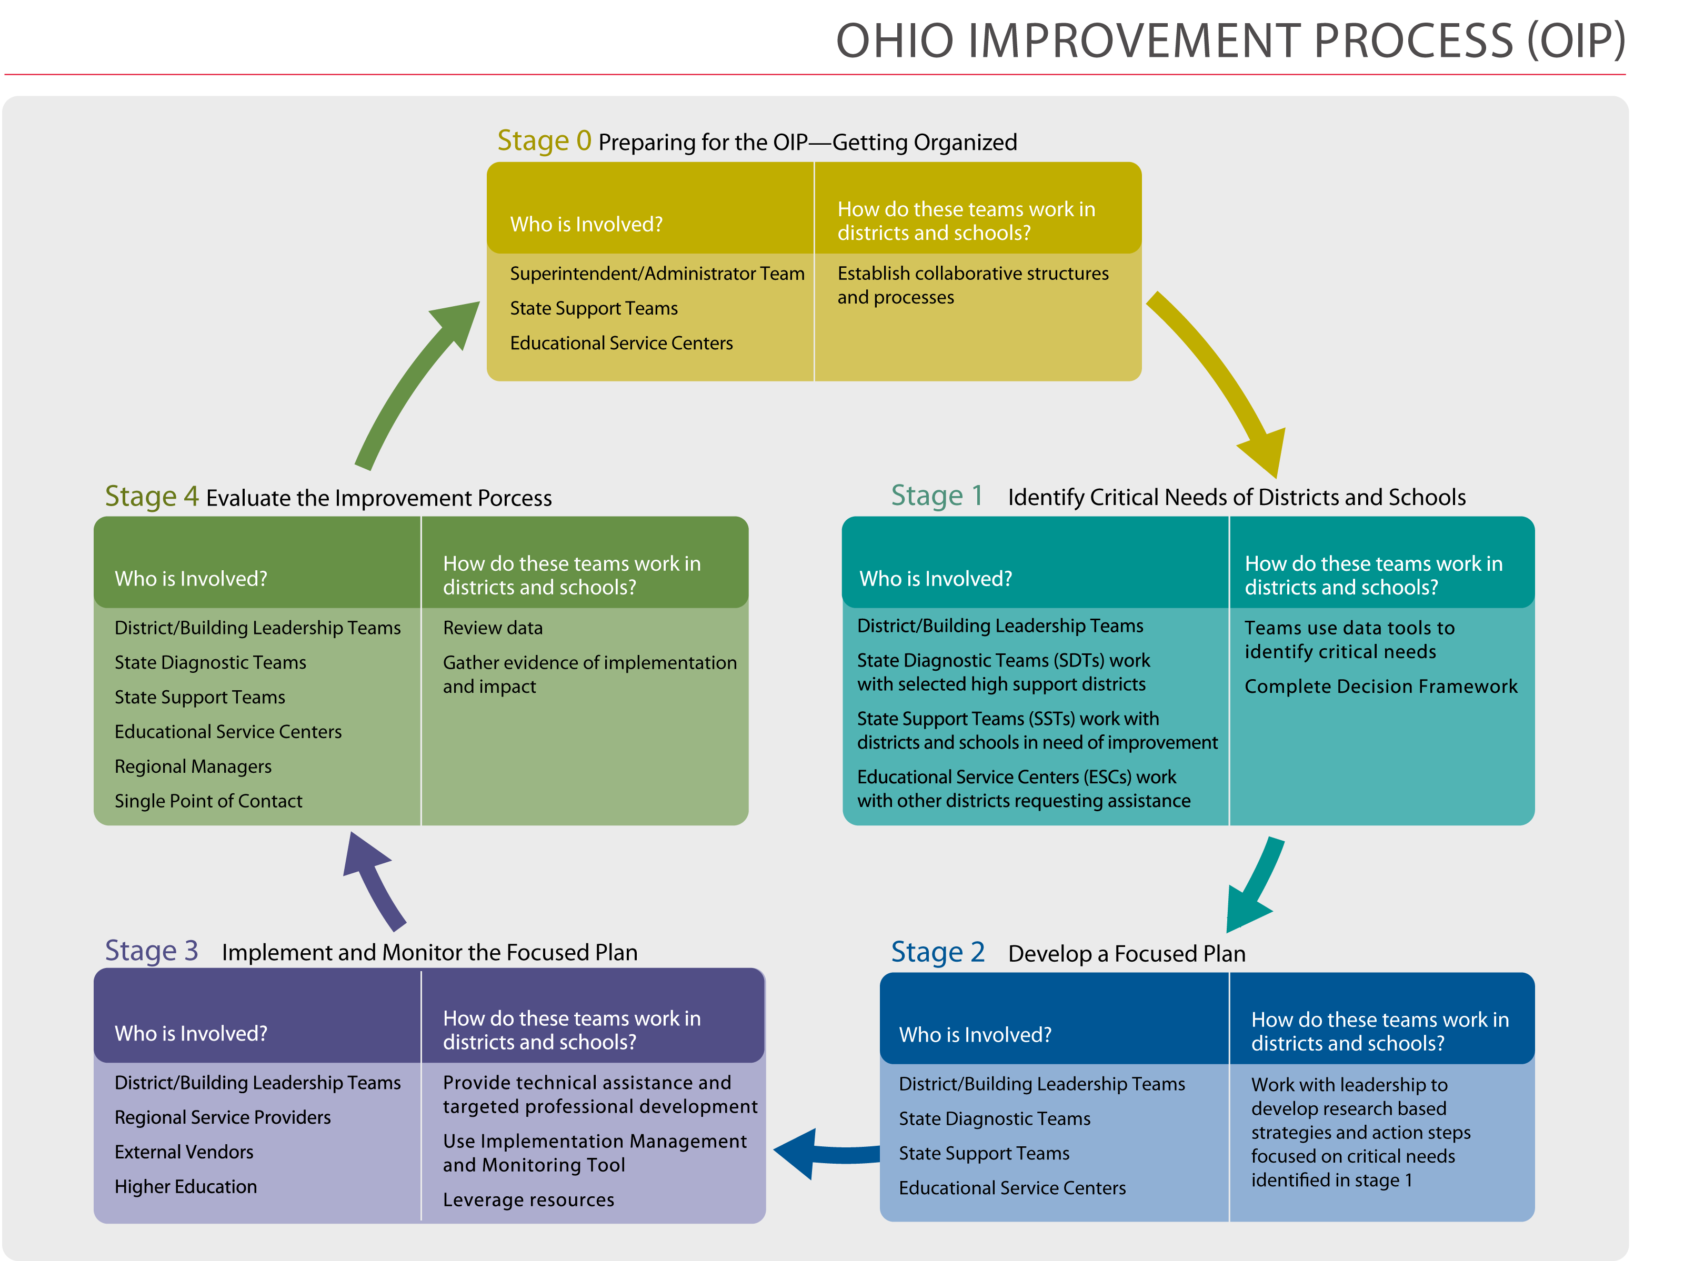

Slide 7
SSoS Service Delivery Model changes with 50 percent less funding
Resources provided:
  Decision Framework
  Implementation Management Monitoring Tool
  High-Quality PD modules
  Website
  Diagnostic Reviews
For 2012:
Restructured Supervision
Diagnostic Reviews for Early Warning
Add three-level review of selected districts
  District data
  Phone review
  Field visit

Slide 8
SST Service Delivery Model changes with 50 percent less funding
State Support Team (SST) and Educational Service Center (ESC) Regional facilitators matched to all Differentiated Accountability LEAs and provided:
  OIP training, as requested
  Face-to-face training and critical friend facilitation
Provides low and medium support LEAs DLT/BLT/TBT technical assistance with OIP implementation

Slide 9
SST Service Delivery Model changes with 50 percent less funding
State Support Team (SST) and Educational Service Center (ESC) Regional facilitators matched to all DA LEAs and provided:
  OIP training, as requested
  Face-to-face training and critical friend facilitation
  Provide high support LEAs with Intensive DLT/BLT/TBT technical assistance including:
    Providing technical assistance in implementing corrective actions from the State Diagnostic Team review and/or the ODE SSoS reviews

